Slide 1
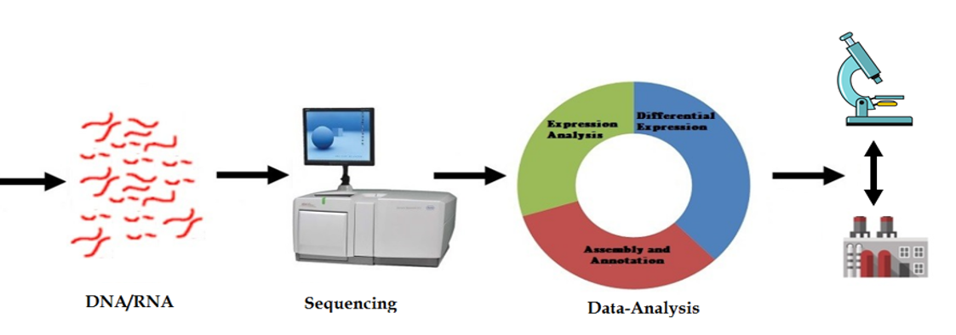
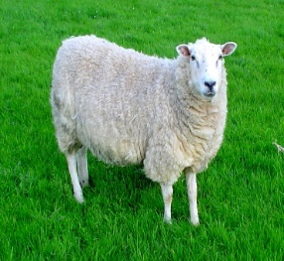
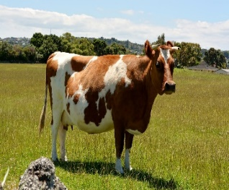
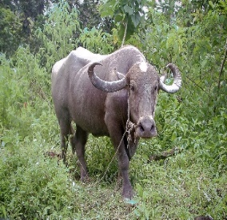
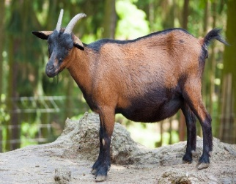
Unix Essential for Genome Data Processing and Analysis
Sandeep Kushwaha, NIAB, Hyderabad, India

Slide 2



Why Unix is Essential for Biologist?
Interaction with computer
Windows and MacOS i.e. GUI
Exploit computer system
i.e. Command line
What is command line ?
Name of command on terminal
Get output on terminal
Everything is text

Slide 3

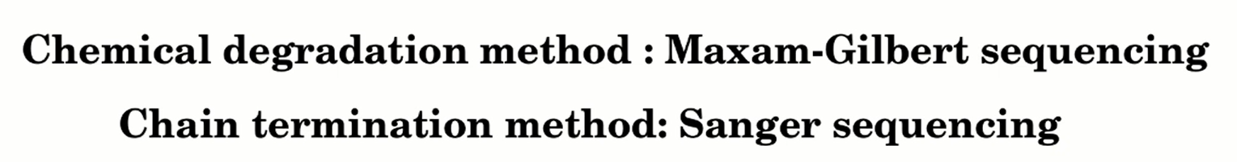
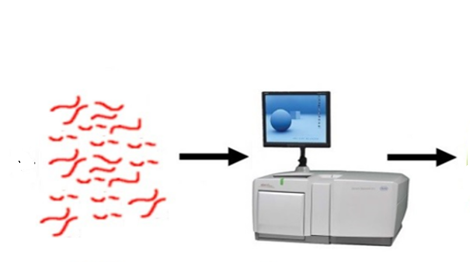
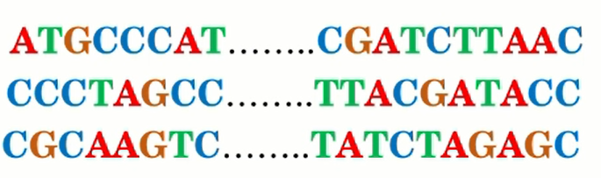
What is genomics data?
DNA/RNA
Sequncer
Sequnces
What is the relevance HTS?

Slide 4
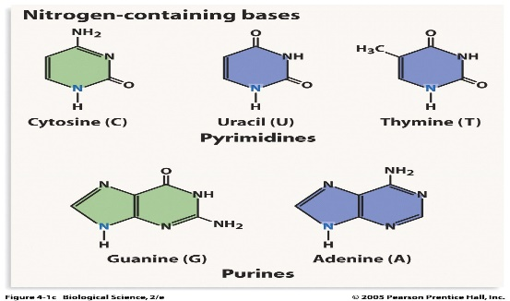
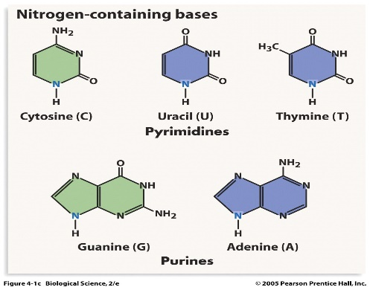
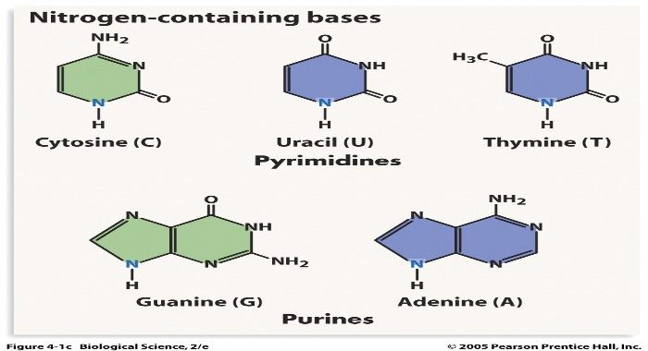
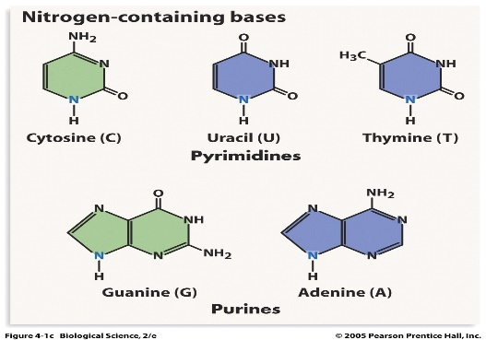
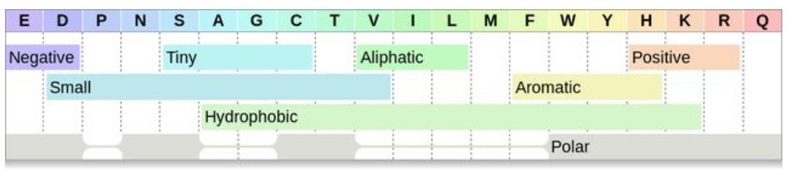
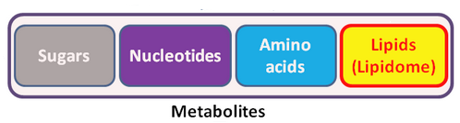
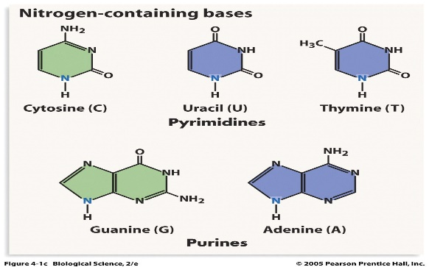
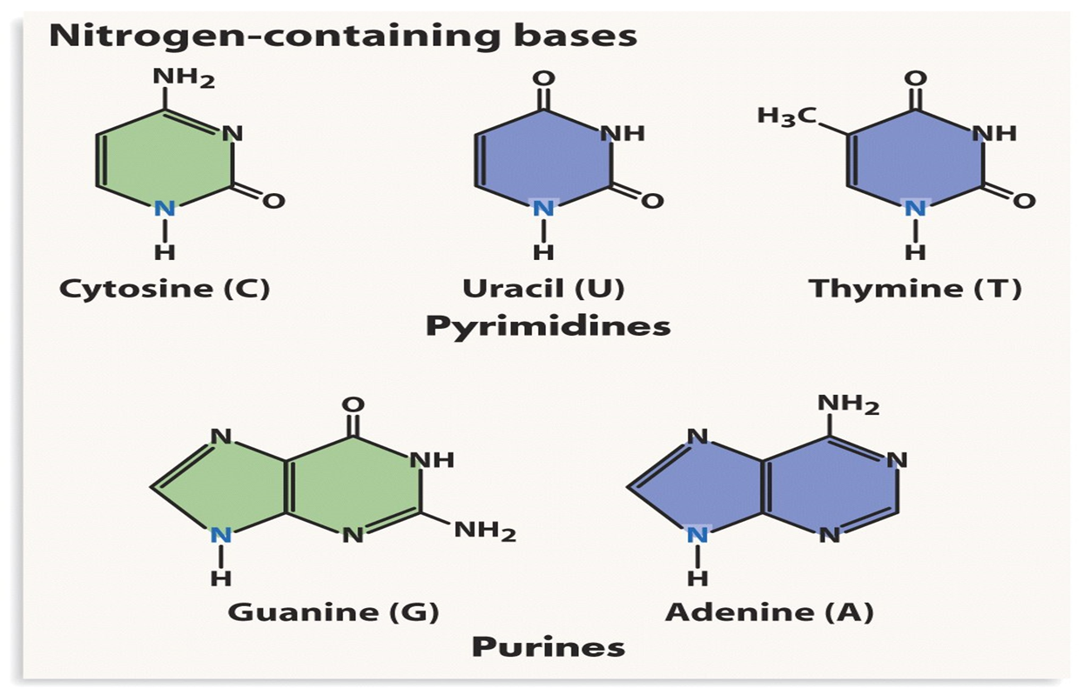
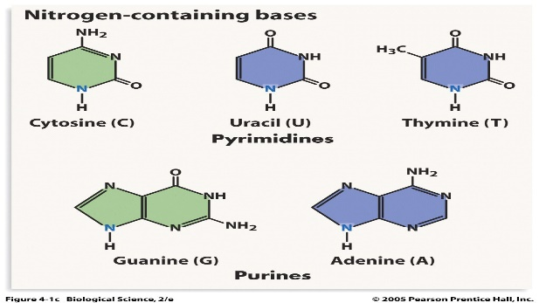
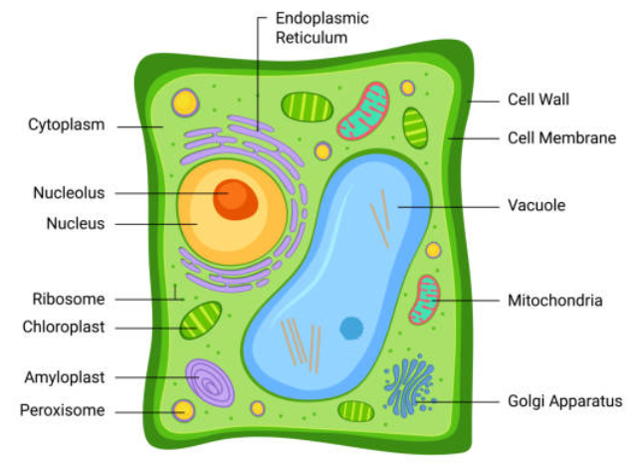
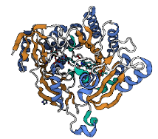






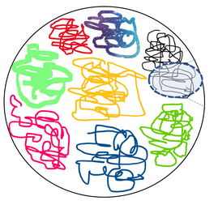
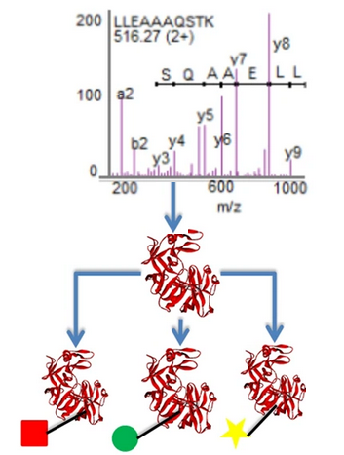

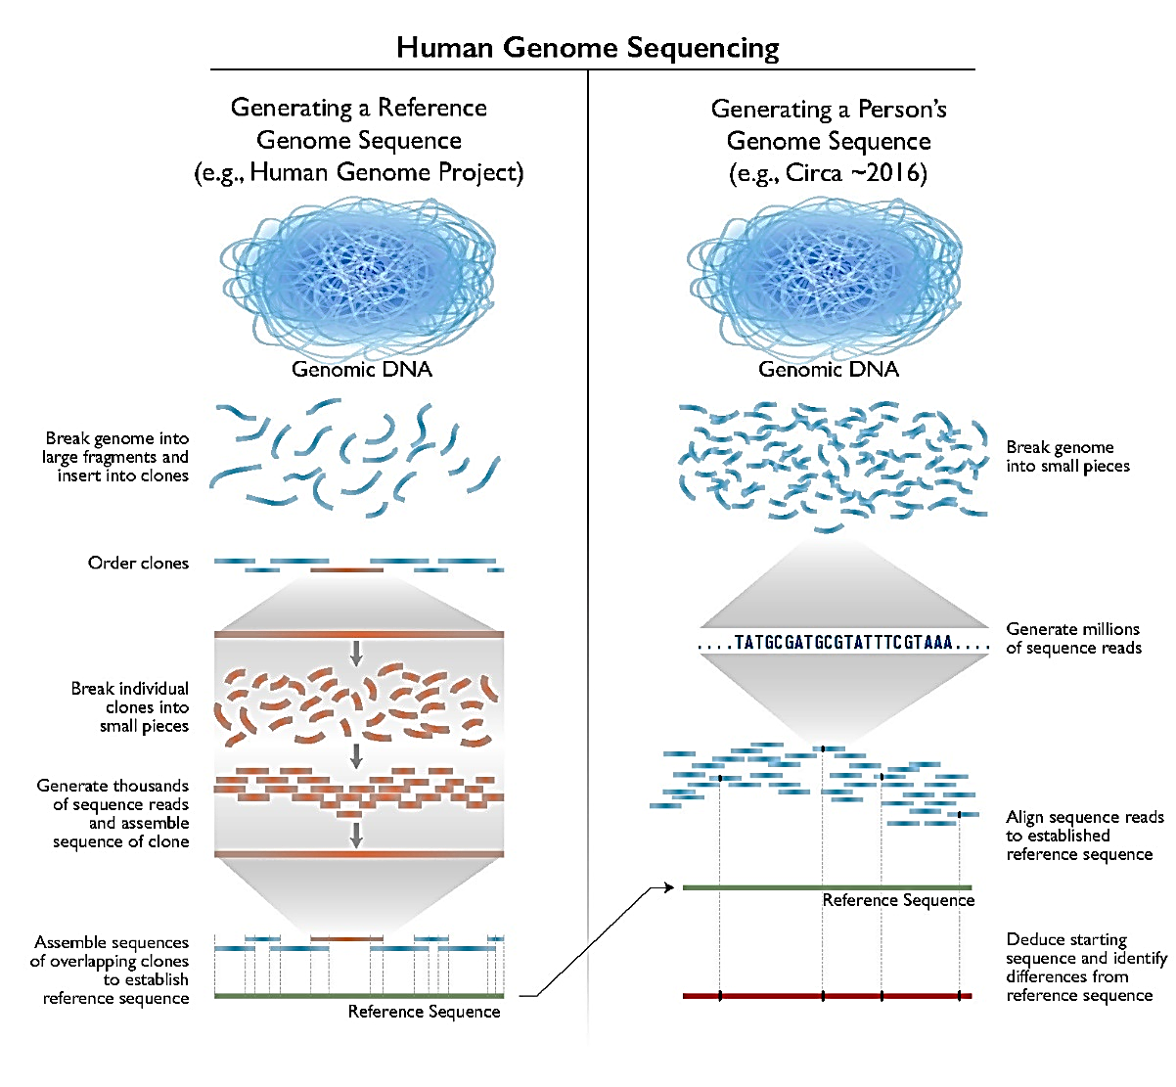
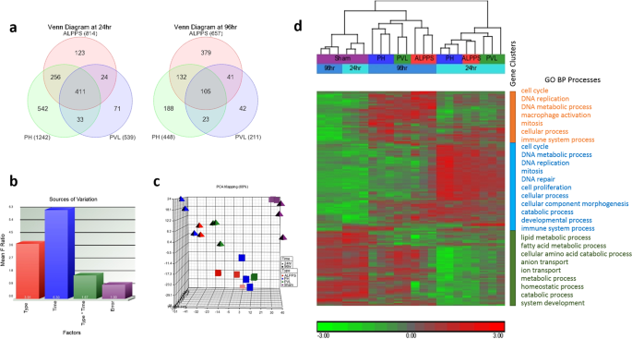
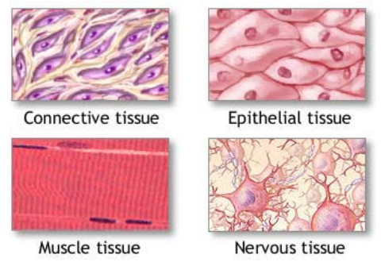
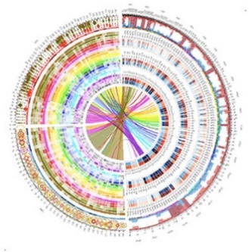
Forward Genetics
DNA
RNA
Cell Function/
Phenotype
Protein
Reverse Genetics
Genomics
Transcriptomics
Proteomics
Phenomics

Slide 5
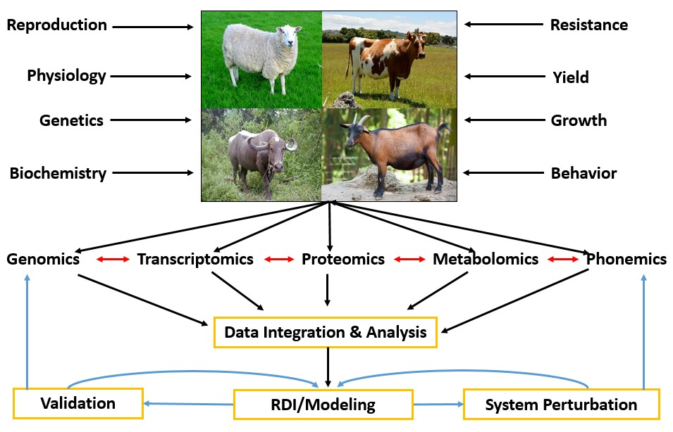
Foundation for bioinformatics
Quick access and processing of large file
Easy data handling and processing
Automation of repetitive tasks
Unix skills for biologist: Data Handling, Data Analysis, Project managements
Power of Unix

Slide 6
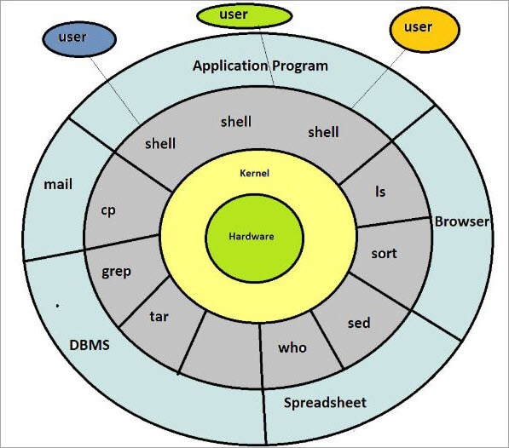
Introduction to Unix
Unix
Environment (set of programs/utilities) to connect computer and user.
Manages computer hardware, software resources, and provides common services for computer : Operating system (OS)
Three part of Unix operating system;
Shell
Shell is the utility to processes your requests
Input at your terminal is interpreted by shell and calls the program to execute your request.
Kernel
Heart of OS, interacts with hardware and computer management like memory, task scheduling and file management
Programs
Various commands and programs for day to day activities such as cp, mv, cat and grep, email

Slide 7
Unix Variants
Grouped into two categories: Proprietary and Open Source
Proprietary: (redistribution and modification prohibited or restricted; not free)
Solaris - Access to a Solaris UNIX server (solaris.gl.umbc.edu) via SSH access.
IRIX - There are a couple of IRIX machines in the basement of the library, as well as server access (irix.gl.umbc.edu) via SSH access.
Mac OS X .
and many others...
Open Source: (source code is readily available and free to modify)
FreeBSD - no access currently available at UMBC.
Linux Distributions –
RedHat (used by UMBC) and the Fedora Project (maintained by RedHat)
Mandrake
Debian
SuSE
Slackware
and many others...
Ubuntu, open-source operating system based on Debian, with a focus on release quality, enterprise security updates and leadership in key platform capabilities for integration, security and usability

Slide 8







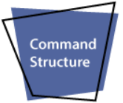

Why Unix
Allows more than one user to access computer resources like main memory, hard disk, tape drives, etc.
Multiple users can log on to the system from different terminals and run different jobs that share the resources of a command terminal
Allows you to initiate more than one task from the same terminal as a foreground and background process.
Allows to work on different machines and platforms
Easy transfer of code to any computer system
UNIX operating system is open source
(freely available).
Highly secure and protected
UNIX keeps an account of jobs created by the user.
Excellent communication features such talk, mail, write
Provides general tools and utilities facilities
Simple and User friendly

Slide 9

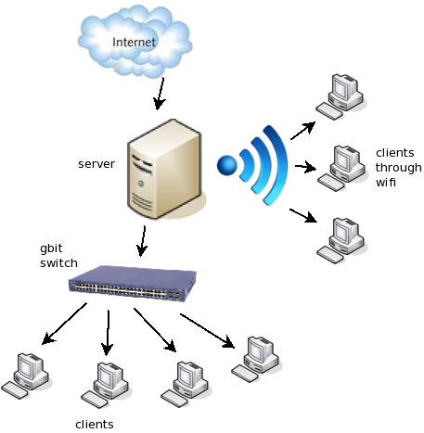
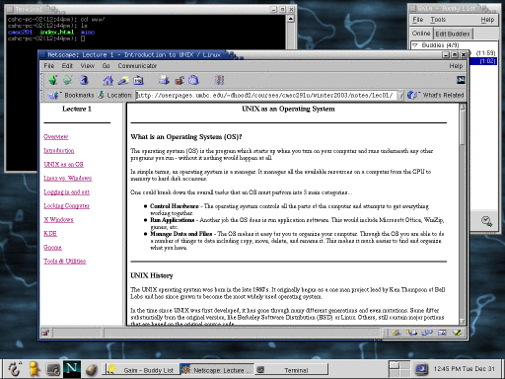
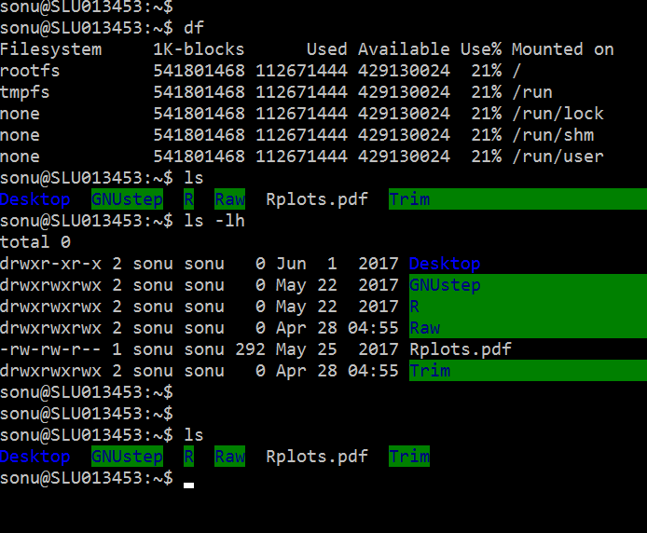
How to work on Unix Interfaces
Two means of working
Logged into Linux computer and work locally. When you logon in this manner you have a full GUI environment.
OR connect remotely to one of the UNIX servers (whether from home or at the labs). When you logon in this manner you have a command line (or text based) environment.

Slide 10
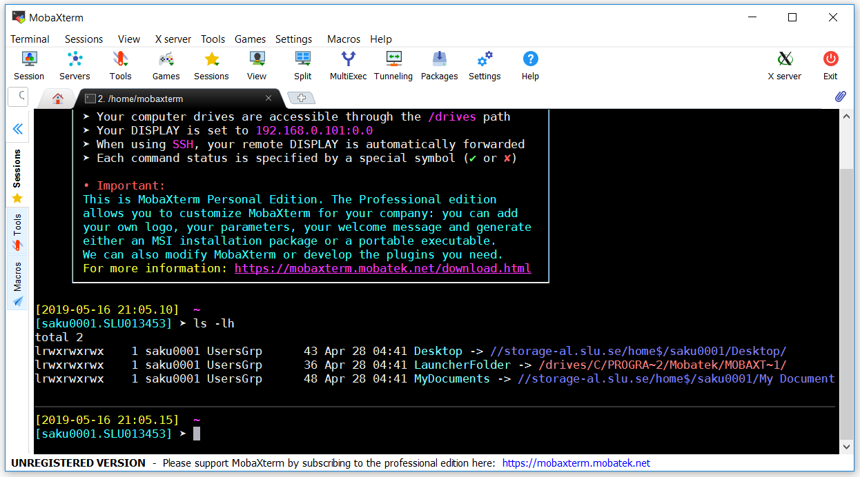
How can you work with Unix
If you are a windows user: You should install MobaXterm
Download
(https://download.mobatek.net/1102018093083521/MobaXterm_Portable_v11.0.zip)
Unzip and go to MobaXterm folder
Click on Exe
Do your job
Exit
Notes:
To start in course, we need unix terminal.
There are many ways to get unix terminel on windows but we will choose easiest path

Slide 11
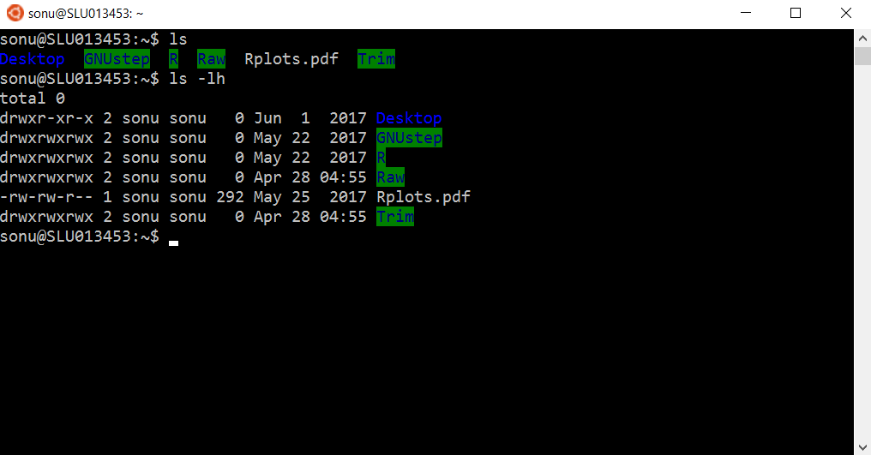
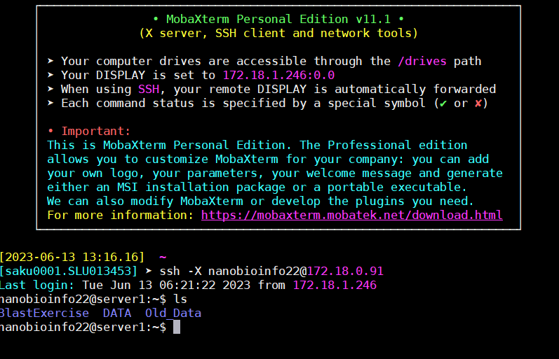
Unix terminal
If you are a Unix OS user:
Type terminal on search option
Open terminal
Do your job
Exit
Work on servers
ip-address : 172.18.0.91
username: nanobioinfo22
pwd:123456
ssh -X nanobioinfo22@172.18.0.91
Passwd:123456
Notes:
To start in course, we need unix terminal.
There are many ways to get unix terminel on windows but we will choose easiest path

Slide 12
1. System information
Number of CPU : ( lscpu )
Similarity search, assembly, networking
Memory information : ( free )
Clustering, Assembly
Disk space and partition: (du –sh/df –lh)
Assembly: trinity, LG-path
OS (uname –a /lsb_release -d)
OS name and version for software compatibility
System load and usages (top)

Slide 13
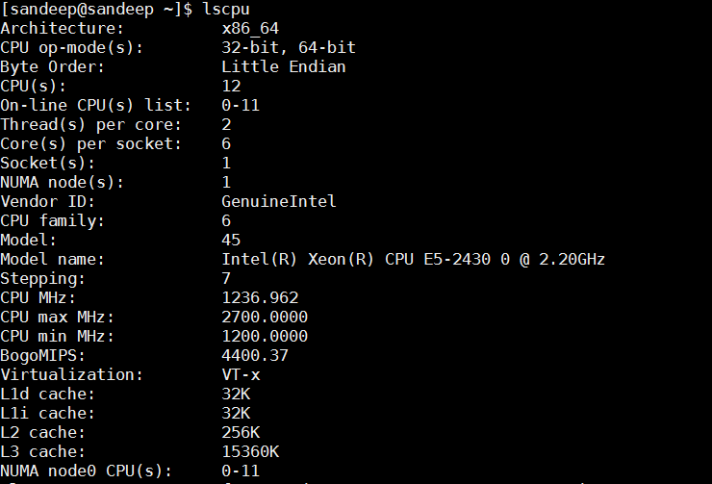
CPU info command: lscpu
Similary search program:
BLAST, PFAM, Interpro
Assembler: Trinity, Spades, ALLPATHS-LG
Alignner : BWA, Bowtie, Star
Expression quantification: htseq, FeatureCount
For more option: lscpu man
Notes:
DF: shows available and used disk space on
df -h shows disk space in human-readable format
df -a shows the file system's complete disk usage even if the Available field is 0
df -T shows the disk usage along with each block's filesystem type (e.g., xfs, ext2, ext3, btrfs, etc.)
df -i shows used and free inodes
DU: shows the disk usage of files, folders
du -h shows disk usage in human-readable format for all directories and subdirectories
du -a shows disk usage for all files
du -s provides total disk space used by a particular file or directory
memory
//proc/meminfo/vmstat
htop/top

Slide 14
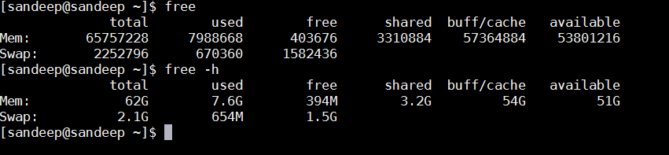
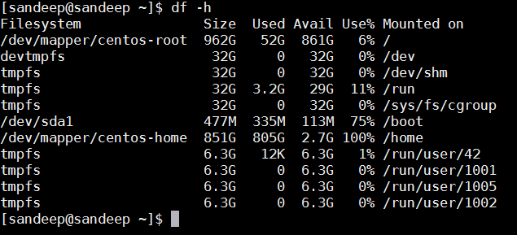
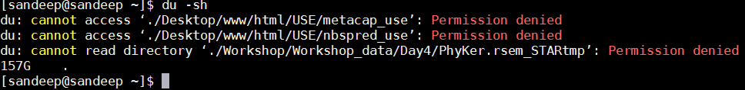
Memory info command: free
-h for human readable
For more option: free man
Assembler: Trinity, Spades, LG-Path
Clustering: cd-hit, Usearch
Most of Networking software
Disk space info command: df/du
Assembler: Trinity, Spades, LG-Path

Slide 15
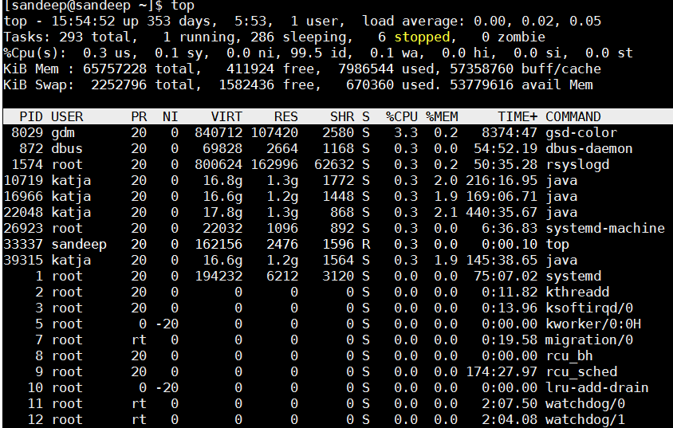
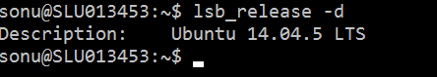
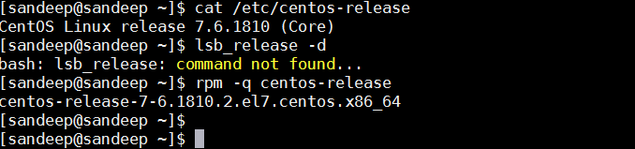
OS info command: uname/lsb_release
System load and usages: top
Kernel name, network node hostname, kernel release date, kernel version, machine hardware name, hardware platform, operating system

Slide 16
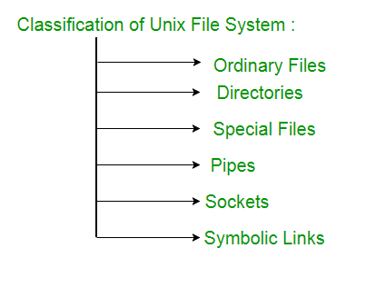
Unix file system
contains data, text, or program instructions.
Directories store both special and ordinary files
Special files are used for device Input/Output(I/O)
Pipe acts a temporary file which hold data from one command until it is read by another.
Socket is a special file which allows for advanced inter-process communication.
Data streaming for local transactions to the filesystem.
Symbolic link is used for referencing some other file of the file system. Symbolic link is also known as Soft link. It contains a text form of the path to the file it references

Slide 17
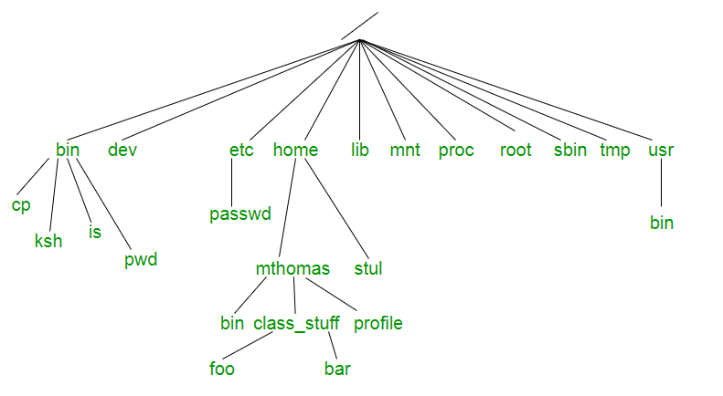
/ ( slash): character denotes the root of the filesystem tree.
/bin (binaries): contains certain fundamental utilities
/dev (devices): Contains file representations of peripheral devices
/etc : Contains system-wide configuration files and system databases.
/home : Contains the home directories for the users.
/lib : Contains system libraries, and some critical files such as kernel modules or device drivers
/usr : Originally the directory holding user home directories
/media : Default mount point for removable devices, such as USB sticks, media players, etc.
/mnt (mount): Contains filesystem mount points. Used to access multiple hard disks or hard disk partitions
/proc : procfs virtual filesystem showing information about processes as files.
/tmp : A place for temporary files.
/root : The home directory for the superuser “root” (system administrator)
/var : A short for “variable.” A place for files that may change often eg: print, mail,log
Unix file system

Slide 18

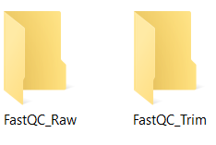
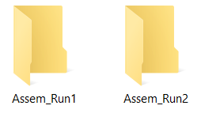


2. Project Management: Genomics Data

Slide 19
A. Listing, creation, removal and listing of file and folder
1. Working/current directory whoami/pwd 2. Listing of files and folders Listing: ls (-l/-h/-a) 3. Make/remove of folder Make directory: Mkdir (-p/-v) Remove directory: Rmdir (-f/-i/-r/-v) 4. Make/remove of files Create file: Touch (empty file)/Nano/Vi/gedit Remove: rm (-i/-v/-f)
5. Data checking Md5sum
WC
Notes:
Steps
1. nano test.txt
2. write something “This is testing of nano text editor “
3. <Control> + O: Save the file
4. Enter
5. <Control> + X: Exit the file
vi’s another text editor
Command usage: vi <file_name>
Mustknow
vi commands similar to nano figure above
Press I
• write “Asdasdfasdwerwerzxccvvzxc”
• Press Esc
• Save and exit : shift + press Z +Press Z
Here is the information about all the listed columns −
First Column − Represents the file type and the permission given on the file. Below is the description of all type of files.
Second Column − Represents the number of memory blocks taken by the file or directory.
Third Column − Represents the owner of the file. This is the Unix user who created this file.
Fourth Column − Represents the group of the owner. Every Unix user will have an associated group.
Fifth Column − Represents the file size in bytes.
Sixth Column − Represents the date and the time when this file was created or modified for the last time.
Seventh Column − Represents the file or the directory name.
In the ls -l listing example, every file line begins with a d, -, or l. These characters indicate the type of the file that's listed.
19

Slide 20
B: Navigation of file and folders
Directories
Present working directories: pwd
Special directories:
Root directory (/): highest directory in system
Home directory(~): home directory of user
Current directory(.): where you are
Parent directory (..): one directory before current directory
Path
Absolute path: i.e start from root/home directories
Relative path: i.e. start from current/parent directories
Command for move, copy, rename
Move: mv (-i/-f/-u/-n)
mv path/source file destination path/
mv stupidname.txt bettername.txt - change name
Copy: cp/scp (-i/-f/-u/-s/-r)
cp stupidname.txt bettername.txt
Notes:
20

Slide 21
C: File reading and writing
Reading
Cat (cat asd.txt)
Less/More(-d) (less/more asd.txt)
Head/Tail (head/tail asd.txt)
Writing
gedit/vi/nano
D: Compress and decompress
Zip
Gzip [c,-k]
tar [-czvf] compressed_file_name Source_file_name
E: File
Notes:
tar [-czvf] name-of-archive.tar.gz stuff
tar -cjvf archive.tar.bz2 stuff
-z: Compress the archive with gzip
-c: Create an archive
-j bz2 compression
-v: Display progress in the terminal while creating the archive, also known as “verbose” mode. The v is always optional in these commands, but it’s helpful.
-f: Allows you to specify the filename of the archive.
x: extract files
-C: extract the contents of the archive to a specific directory
-k, keep source file
--totals
gzip
gzip {filename}
gzip mydata.doc
gzip -d {.gz file}
gzip -d mydata.doc.gz
gunzip {.gz file}
gunzip mydata.doc.gz
bzip2
bzip2 {filename}
bzip2 mydata.doc
bzip2 -d {.bz2-file}
bzip2 -d mydata.doc.bz2 bunzip2 {.bz2-file}
bunzip mydata.doc.gz
zip
zip {.zip-filename} {filename-to-compress}
zip mydata.zip mydata.doc
unzip {.zip file}
unzip file.zip
tar
tar [-czvf] name-of-archive.tar.gz stuff
tar -cjvf archive.tar.bz2 stuff
tar -xzvf archive.tar.gz
tar -xjvf archive.tar.bz2
21

Slide 22
Program | Compression | Decompression
gzip | gzip {filename} gzip mydata.doc | gzip -d {.gz file} gzip -d mydata.doc.gz gunzip {.gz file} gunzip mydata.doc.gz
bzip2 | bzip2 {filename} bzip2 mydata.doc | bzip2 -d {.bz2-file} bzip2 -d mydata.doc.bz2 bunzip2 {.bz2-file} bunzip mydata.doc.gz
zip | zip {.zip-filename} {filename-to-compress} zip mydata.zip mydata.doc | unzip {.zip file} unzip file.zip
tar | tar [-czvf] name-of-archive.tar.gz stuff tar -cjvf archive.tar.bz2 stuff | tar -xzvf archive.tar.gz tar -xjvf archive.tar.bz2

Slide 23
Quick Revision
OS: uname(-a), lsb release –a CPU architecture: lscpu
Memory info: free –m Free disk: df (-lh/-a/-T/-i)
Disk usages: du (-lh/-a/-s) Users: w/who, last, bg, fg
System load and usages: top
Make folder: mkdir Change directory: cd
Writing: gedit/vi/nano Reading: Cat/Less/More/Head/Tail
Move: mv (-i/-f/-u/-n) Copy: cp (-i/-f/-u/-s/-r)
Compress/decompress : tar/gzip/bzip2/zip
Notes:
tar [-czvf] name-of-archive.tar.gz stuff
tar -cjvf archive.tar.bz2 stuff
-z: Compress the archive with gzip
-c: Create an archive
-j bz2 compression
-v: Display progress in the terminal while creating the archive, also known as “verbose” mode. The v is always optional in these commands, but it’s helpful.
-f: Allows you to specify the filename of the archive.
x: extract files
-C: extract the contents of the archive to a specific directory
-k, keep source file
--totals
gzip
gzip {filename}
gzip mydata.doc
gzip -d {.gz file}
gzip -d mydata.doc.gz
gunzip {.gz file}
gunzip mydata.doc.gz
bzip2
bzip2 {filename}
bzip2 mydata.doc
bzip2 -d {.bz2-file}
bzip2 -d mydata.doc.bz2 bunzip2 {.bz2-file}
bunzip mydata.doc.gz
zip
zip {.zip-filename} {filename-to-compress}
zip mydata.zip mydata.doc
unzip {.zip file}
unzip file.zip
tar
tar [-czvf] name-of-archive.tar.gz stuff
tar -cjvf archive.tar.bz2 stuff
tar -xzvf archive.tar.gz
tar -xjvf archive.tar.bz2
23

Slide 24
Routine Bioinformatics Task
Sequence counting and Composition
Check file integrity and format
(a) Sequence Counting
cat Sample_75.fq | wc -l
cat Sample_75.fq | grep -c "^@SIM“
cat Sample_75.fa|grep –c ”\>”
b)Total number of nucleotides
less DATA/Test.fq |paste - - - -|cut -f 2|tr -d '\n'|wc
less DATA/Test.fa
c)Number of A/T/G/C
less DATA/Test.fq |paste - - - -|cut -f 2|tr -d '\n'|fold -w 1|sort|uniq -c
less Test.fq |paste - - - -|cut -f 2|tr -d "\n"|sed 's/.../&\n/g'
d) AT/GC content ?

Slide 25
Routine Bioinformatics Task
Grep (global regular expression print)
Syntax: grep [options] pattern [files]
Options Description
-c : Prints only a count of the lines that match a pattern
-n : Display the matched lines and their line numbers.
-w : Match whole word
-v : Prints out all the lines that do not matches the pattern
-A : Print number of line after pattern matching
-B : Print number of line before pattern matching
-f : Takes patterns from file, one per line.
-i : Ignores, case for matching (for non-case sensitivity )
less DATA/Test.fa|grep -c "Seq“
less DATA/Test.fa|grep -ci "Seq“
less DATA/Test.fa|grep -in "Seq“
less DATA/Test.fa|grep -inw "Seq“
less DATA/Test.fa|grep "Seq" -A 1 (Troubleshooting)
less DATA/Test.fa|grep "Seq" -B 1 (Troubleshooting)

Slide 26
Routine Bioinformatics Task
Wc (Word Count)
Syntax : wc [-l/w/c]... [FILES]...
Options Description
-l : To get line number only
-w : To get words only
-c : To get character only
-L: to print out the length of longest line
less DATA/Test.fa |wc
less DATA/Test.fa|wc -l
less DATA/Test.fa|wc -c
less DATA/Test.fa|wc

Slide 27
Routine Bioinformatics Task
cut (used to cutting out the sections from each line of files for data processing)
Syntax : cut OPTION... [FILE]...
Options Description
-b : To cut by bytes, with the list of byte numbers separated by comma or range by -
-c : To cut by character, with the list of byte numbers separated by comma or range by -
-f : To cut by field, with the list of byte numbers separated by comma or range by -
-d : cut by delimiter
cat DATA/id.txt
less DATA/id.txt |cut -b 1-3 less DATA/id.txt |cut -b 3-6
less DATA/id.txt |cut -b -3 less DATA/id.txt |cut -b 3-
less DATA/id.txt |cut -d “_” -f 1 less DATA/id.txt |cut -d “_” -f 2
less DATA/id.txt |cut -d “_” -f 1,2 less DATA/id.txt |cut -d “_” -f 1-2
Blast file filtering/Sub-setting
less DATA/Blast_file.txt |head less DATA/Blast_file.txt |cut -f 2-5
less DATA/Blast_file.txt |cut -f 2,5 less DATA/Blast_file.txt |wc -l
less DATA/Blast_file.txt |grep -P "(.*null){11}“|wc -l
less DATA/Blast_file.txt |grep -v -P "(.*null){11}“|wc –l less DATA/Blast_file.txt |grep “|”

Slide 28
Routine Bioinformatics Task
Paste (Use to merge of file content)
Syntax : paste [-d/s] file1 file2
Options Description
-d : To define delimiter for joining
-s : To join file content horizontally
cat DATA/id.txt cat DATA/family.txt
paste DATA/id.txt DATA/family.txt paste –d “|” DATA/id.txt DATA/family.txt
paste -s DATA/id.txt DATA/family.txt cat DATA/id.txt DATA/family.txt |paste - - -

Slide 29
Routine Bioinformatics Task
sort (Use to sort file content line by line)
Syntax : sort [-n/r/k] <file_name>
Options Description
-r: reverse the result of comparisons
-k: KEYDEF gives location and type
-n: compare according to string numerical value
-b: ignore leading blanks
cat DATA/Features.txt cat DATA/Exon.txt
cat DATA/Features.txt|sort cat DATA/Exon.txt|sort
cat DATA/Exon.txt|sort -n cat DATA/Exon.txt|sort -n -k 2
cat DATA/Exon.txt|sort -n -k 2 -r

Slide 30
Routine Bioinformatics Task
uniq (used to reports or filter out repeated lines in a file line by line)
Syntax : uniq [options] [files]
Options Description
-c : prints how many times a line was repeated by displaying a number
-d : prints the repeated lines and not the lines which aren’t repeated
-i : ignore case.
-u : print only unique lines.
cat DATA/Exon.txt cat DATA/Exon.txt|uniq
cat DATA/Exon.txt|cut -d " " -f 1 |uniq cat DATA/Exon.txt|cut -d " " -f 2 |uniq
cat DATA/Exon.txt|cut -d " " -f 2 |sort|uniq cat DATA/Exon.txt|cut -d " " -f 1 |sort|uniq –c
cat DATA/Exon.txt|cut -d " " -f 1 |sort|uniq –u cat DATA/Exon.txt|cut -d " " -f 1 |sort|uniq -d
Fold (to break lines)
Syntax : fold [options] [files]
Options Description
-s: break at spaces
-w: use columns WIDTH

Slide 31
2. Data Extraction to Plot Analysis Graph
Experiment : Functional diversity of Cazy Enzymes fungus
Data : RNA-Seq
Processed : Transcriptome (Generated Transcripts)
Analysis:
How many cazy familes were present?
How many sub-familes of each Cazy families were present?

Slide 32
2. Extraction of data to plot graph
Blast file filtering/Sub-setting
less ../Day2/Blast_file.txt |head less ../Day2/Blast_file.txt |grep “|”
cat ../Day2/Blast_file.txt |grep "|"|cut -f 5
cat ../Day2/Blast_file.txt |grep "|"|cut -f 5|cut -d "|" -f 2
Counting of Famlies
cat ../Day2/Blast_file.txt |grep "|"|cut -f 5|cut -d "|" -f 2|grep -c "GH“
cat ../Day2/Blast_file.txt |grep "|"|cut -f 5|cut -d "|" -f 2|grep -c "GT“
cat ../Day2/Blast_file.txt |grep "|"|cut -f 5|cut -d "|" -f 2|grep -c “CBM“
cat ../Day2/Blast_file.txt |grep "|"|cut -f 5|cut -d "|" -f 2|grep -c “CE“
cat ../Day2/Blast_file.txt |grep "|"|cut -f 5|cut -d "|" -f 2|grep -c “PL“
cat ../Day2/Blast_file.txt |grep "|"|cut -f 5|cut -d "|" -f 2|grep -c “AA“
Counting of Sub-famlies
cat ../Day2/Blast_file.txt |grep "|"|cut -f 5|cut -d "|" -f 2|grep "GH“|sort|uniq –c
cat ../Day2/Blast_file.txt |grep "|"|cut -f 5|cut -d "|" -f 2|grep "GT“|sort|uniq -c
cat ../Day2/Blast_file.txt |grep "|"|cut -f 5|cut -d "|" -f 2|grep “CBM“|sort|uniq –c
cat ../Day2/Blast_file.txt |grep "|"|cut -f 5|cut -d "|" -f 2|grep “CE“|sort|uniq -c
cat ../Day2/Blast_file.txt |grep "|"|cut -f 5|cut -d "|" -f 2|grep “AA“|sort|uniq -c

Slide 33
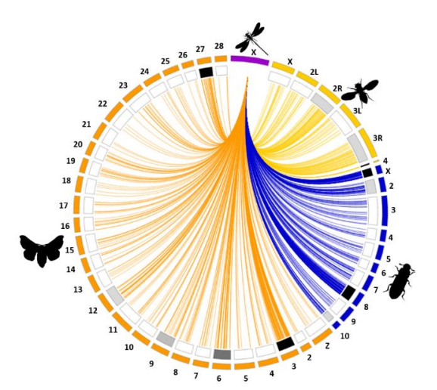
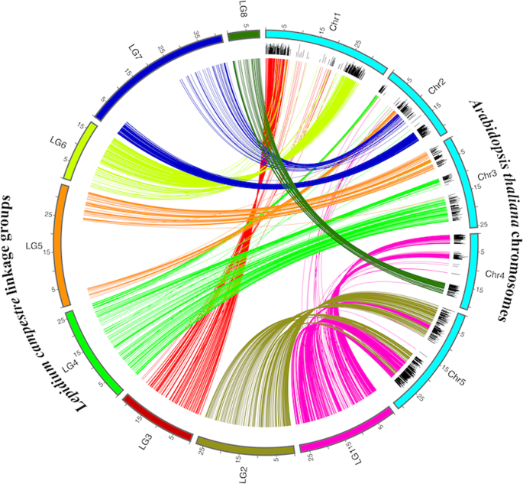
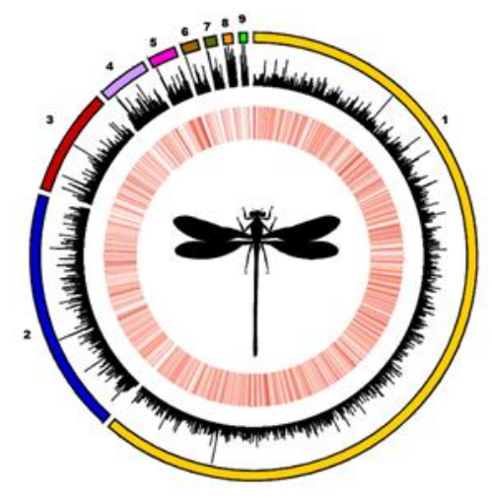

Slide 34
Some more … common bioinformatics task
sed (used to reports or filter out repeated lines in a file line by line)
Syntax : sed "s/<pattern to match>/<pattern to replace with>/<options>"
Options Description
g- Global match - Replace more than one hit.
i- Case insensitive match
cat Filename|sed ‘s/Patternfor matching/,/Replacement Pattern/p'
cat Filename|sed -n '/PatternStart/,/PatternEnd/p'

Slide 35
1. Fastq to Fasta sequence
zcat ../Day2/Test.fq.gz |grep “^@ERR" -A 1|sed 's/--//'|sed '/^$/d'|sed 's/^@/>/‘
zcat ../Day2/Test.fq.gz |paste - - - -|cut -f 1-2|sed 's/@/>/'|sed 's/\t/\n/’
zcat ../Day2/Test.fq.gz |sed -n '1~4s/^@/>/p;2~4p‘ >Test.fa
2. Splitting of fasta sequence file
3. Conversion of single line fasta sequence into multiple line fasta sequence or vice-versa
less urseqfile|sed 's/^>/#>/'|sed 's/$/%/'|sed 's/!^>$//'|tr -d "\n"|tr "#" "\n"|sed 's/%/@/'|sed 's/%//g' >sequence_oneline.fasta
cat sequence_oneline.fasta|grep -f ids|sed 's/@/\n/' >extracted_seqless
sequence_oneline.fasta |awk '{ if(length($0)>2000)print $0}'|wc –l
4. Random dataset generation for fastq and fasta file
5. Extraction of gene sequence of interest from genome file
8. Creation of non redundant dataset

Slide 36
Hands-on : Similarity search for large set of sequences
Use online blast service
Use offline service
Run against specific database
Open NCBI → Genome -→ paste Magnaporthe oryzae in search box
Download genome and protein sequences from command line
wget : paste genome link
wget : paste proteome link
C. Unzip the download file
D. Check the content of file (protein/DNA)
E. Make database from proteom file
makeblastdb -in ../Day2/BlastExercise/GCF_000002495.2_MG8_protein.faa -dbtype prot -out MO
F. Perform similarity search
blastp -query ../Day2/BlastExercise/ProteinSeq.fa -db MO -out ProteinSeq.blastp
G. Explore in-built filters i.e. evalue, num_descriptions, num_alignment

Slide 37
Hands-on : Similarity search for large set of sequences
Run against public database
Download nucleotide and protein sequences command line
Protein sequences : Uniport/NCBI (NR)
wget : paste link (Dont try. It is for demonstration only)
C. Unzip the download file
D. Check the content of file (protein)
E. Make database from proteom file
makeblastdb -in Uniref ---fasta -dbtype prot -out MO
F. Perform similarity search
blastp -query ProteinSeq.fa –db /home/Databases/Uniport/Uniref100 -out ProteinSeqUniRef.blastp

Slide 38
Course Material of Training Program
https://github.com/bioinfokushwaha/TrainingProgram-on-Bioinformatics-and-Genomics/wiki

